Slide 1
TOPIC A1:
COMPUTER FUNDAMENTALS
LESSON A1-7
SCHEDULING & PROCESSES

Slide 2
AGENDA
Processes and the ready queue
First-come first-served
Round robin
Priority and multilevel queue
Comparing the four
Polling and interrupts
Multitasking and deadlock [HL]
Lab
Close
WHAT U NEED 4 LESSON
Guided Notes

Slide 3

THE WARM UP QUESTION
Q1
(a) State the function that decides which process gets the CPU
(b) State what is meant by system integrity
→ Notes Q1 (a)-(c) [3 marks]

Slide 4
THE WARM UP ANSWER
(a) Scheduling
(b) The machine staying in a correct, consistent, working state

Slide 5


PROCESSES AND THE READY QUEUE
A process is a program that is currently running on your computer
It has its own memory, its own files and its own place in the queue
A thread is one sequence of instructions inside a process
One process can hold many threads, which is why we saw that ~200 processes had ~3,000 threads in Task Manager

Slide 6
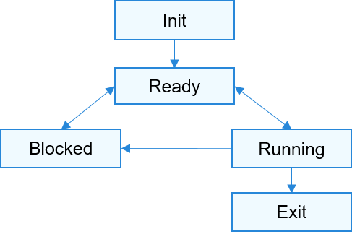
PROCESSES AND THE READY QUEUE
Ready – a process is waiting for a turn on the CPU
Running – a process is on the CPU right now, one per core
Blocked – a process is waiting on something slower, usually input or a disk
  A blocked process does not sit on the CPU doing nothing, which frees up time for other processes
The ready queue is the line of processes waiting their turn

Slide 7
PROCESSES AND THE READY QUEUE
Burst time is how long a process needs on the CPU
  This is how long that task needs to complete its goal
All four arrive at roughly the same time, 0, but they have different stated priorities
→ Notes Q2 (a)-(c) [3 marks]
Process | Burst (ms) | Priority
P1 | 8 | 3
P2 | 4 | 1
P3 | 2 | 4
P4 | 6 | 2

Slide 8
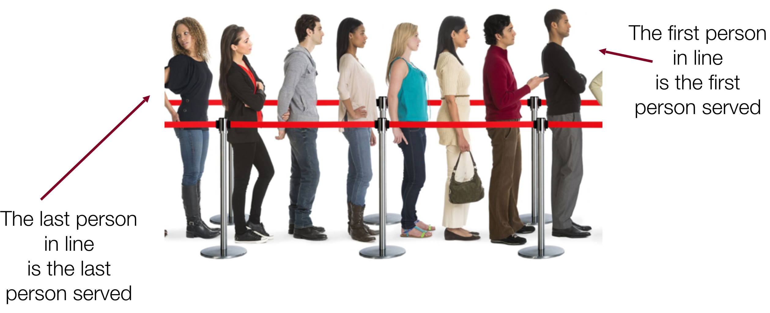
FIRST-COME FIRST-SERVED
First-come first-served runs each process to completion, in arrival order
No interruptions, no reordering, no cuts no buts no coconuts
P1 arrived first, so P1 gets all 8 ms before anyone else moves
Waiting time is how long a process sits in the queue before it starts
  This is very much like the queue data structure

Slide 9

FIRST-COME FIRST-SERVED
The response times are 0, 8, 12 and 14 ms, average of 8.5 ms
  Response time – how long it takes for the CPU to run a process for the first time
Average exit/completion time is 34 ÷ 4 = 13.5 ms
P3 only needs 2 ms of CPU but has to wait 12 ms to get access to the CPU
0 – 8 | 8 – 12 | 12 – 14 | 14 – 20
P1 | P2 | P3 | P4
Task P4

Slide 10
FIRST-COME FIRST-SERVED
This is simple to build and no task is ever skipped
  But one long process at the front delays everything behind it
→ Notes Q3 (a)-(b) [4 marks]

Slide 11
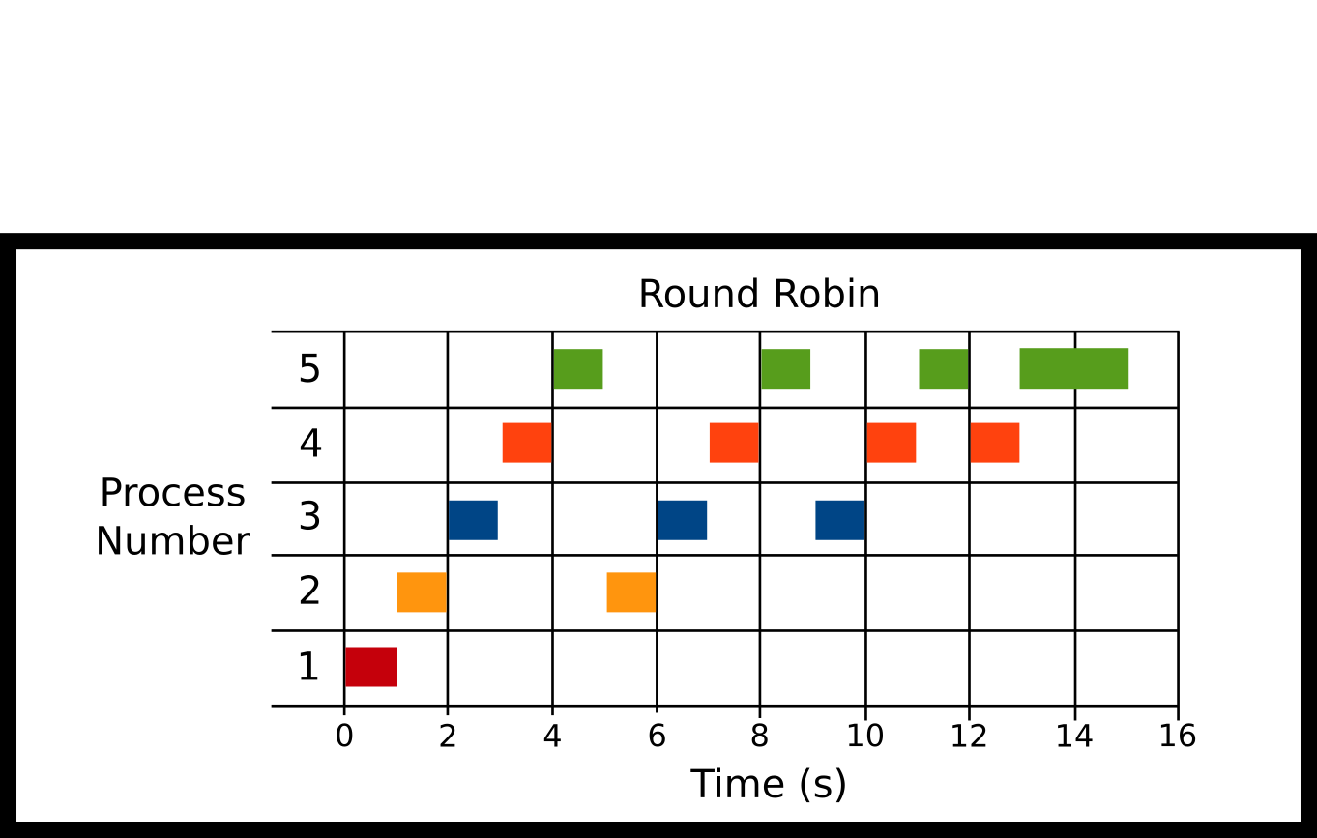
ROUND ROBIN
Round robin gives every process a fixed amount of time with the CPU,a slice of its time, called a time quantum
  Although I tend to call it a time slice
If a task does not complete in its slice, it gets kicked to the back of the queue
Let’s assume a quantum of 2 ms using the same four processes

Slide 12
ROUND ROBIN
We now have ten slices instead of four, because processes keep alternating
Every process gets its first turn inside the first 8 ms
Every time a process changes is called a context switch
  This introduces overhead, since the cache will likely be full of addresses from the first process that need to be cleared out for the second, costing time
  Our model doesn’t account for this
0-2 | 2-4 | 4-6 | 6-8 | 8-10 | 10-12 | 12-14 | 14-16 | 16-18 | 18-20
P1 | P2 | P3 | P4 | P1 | P2 | P4 | P1 | P4 | P1

Slide 13
ROUND ROBIN
Average response time drops from 8.5 ms to 3.0 ms
Average exit/completion time rises from 13.5 ms to 14 ms
So round robin is fairer and more responsive, but finishes slightly later
A small quantum means better response, but more switching overhead
→ Notes Q4 (a)-(b) [4 marks]
0-2 | 2-4 | 4-6 | 6-8 | 8-10 | 10-12 | 12-14 | 14-16 | 16-18 | 18-20
P1 | P2 | P3 | P4 | P1 | P2 | P4 | P1 | P4 | P1

Slide 14
PRIORITY AND MULTILEVEL QUEUE
Priority scheduling runs the most important process first
Our table has priority 1 as the highest and 4 as the lowest
So the order becomes P2, then P4, then P1, then P3
  Real systems set priority by importance or deadlines

Slide 15

PRIORITY AND MULTILEVEL QUEUE
If you’ve ever gotten into Pokemon battling, it works pretty much identically
There are priority tiers, and within a tier whichever shows up first (is fastest) goes first

Slide 16
PRIORITY AND MULTILEVEL QUEUE
Average response time is 8ms, which is better than FCFS, but worse than RR
Average exit/completion time is 13ms, once again respectable
P3 has the lowest priority and has to wait for 18 of the 20 ms
If more important tasks keep rolling in, P3 may never run at all, which is called starvation
0 – 4 | 4 – 10 | 10 – 18 | 18 – 20
P2 | P4 | P1 | P3

Slide 17
PRIORITY AND MULTILEVEL QUEUE
Multilevel queue scheduling uses several ready queues at once
Interactive work sits in a high queue, background work in a low one
Each queue can run its own rule
  Usually round robin at the top
The scheduler serves the top queue first, then works down
→ Notes Q5 (a)-(c) [4 marks]

Slide 18
COMPARING THE FOUR
Using the same four processes across all three, we get the following
None of these are inherently better than the others
  It’s a tradeoff
Multilevel queue is not on this table because it depends on its queues
Rule | Avg response | Avg exit | Main flaw
First-come first-served | 8.5 ms | 13.5 ms | Long jobs block
Round robin (q = 2) | 3.0 ms | 14.0 ms | Switch overhead
Priority | 8.0 ms | 13.0 ms | Starvation

Slide 19
COMPARING THE FOUR
You should identify which of these situations you are in before deciding on a scheduling algorithm
  Use first-come first-served when jobs are similar and order is fair
  Use round robin when people are waiting for each process to run, like interactive applications
  Use priority when there is difference in importance levels between the work
Use multilevel queue when multiple kinds of work must be done on once computer
→ Notes Q6 (a)-(c) [3 marks]

Slide 20

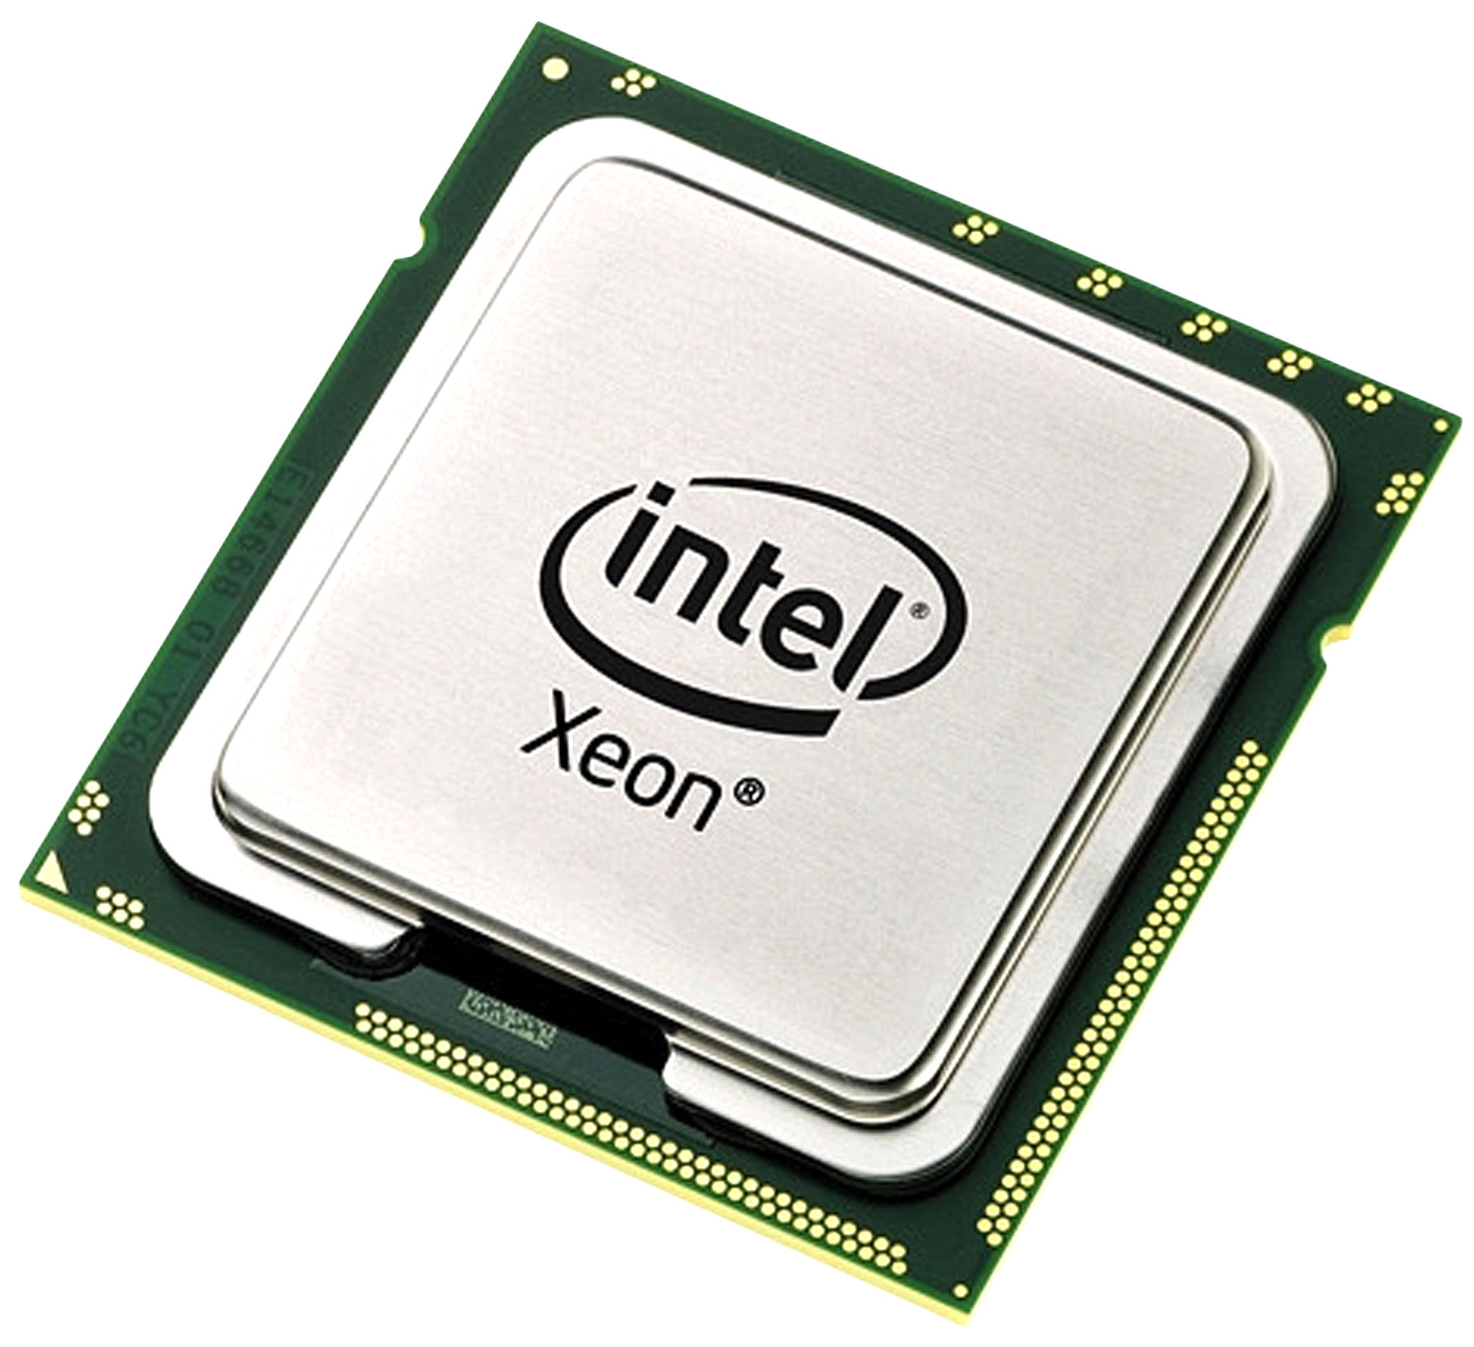
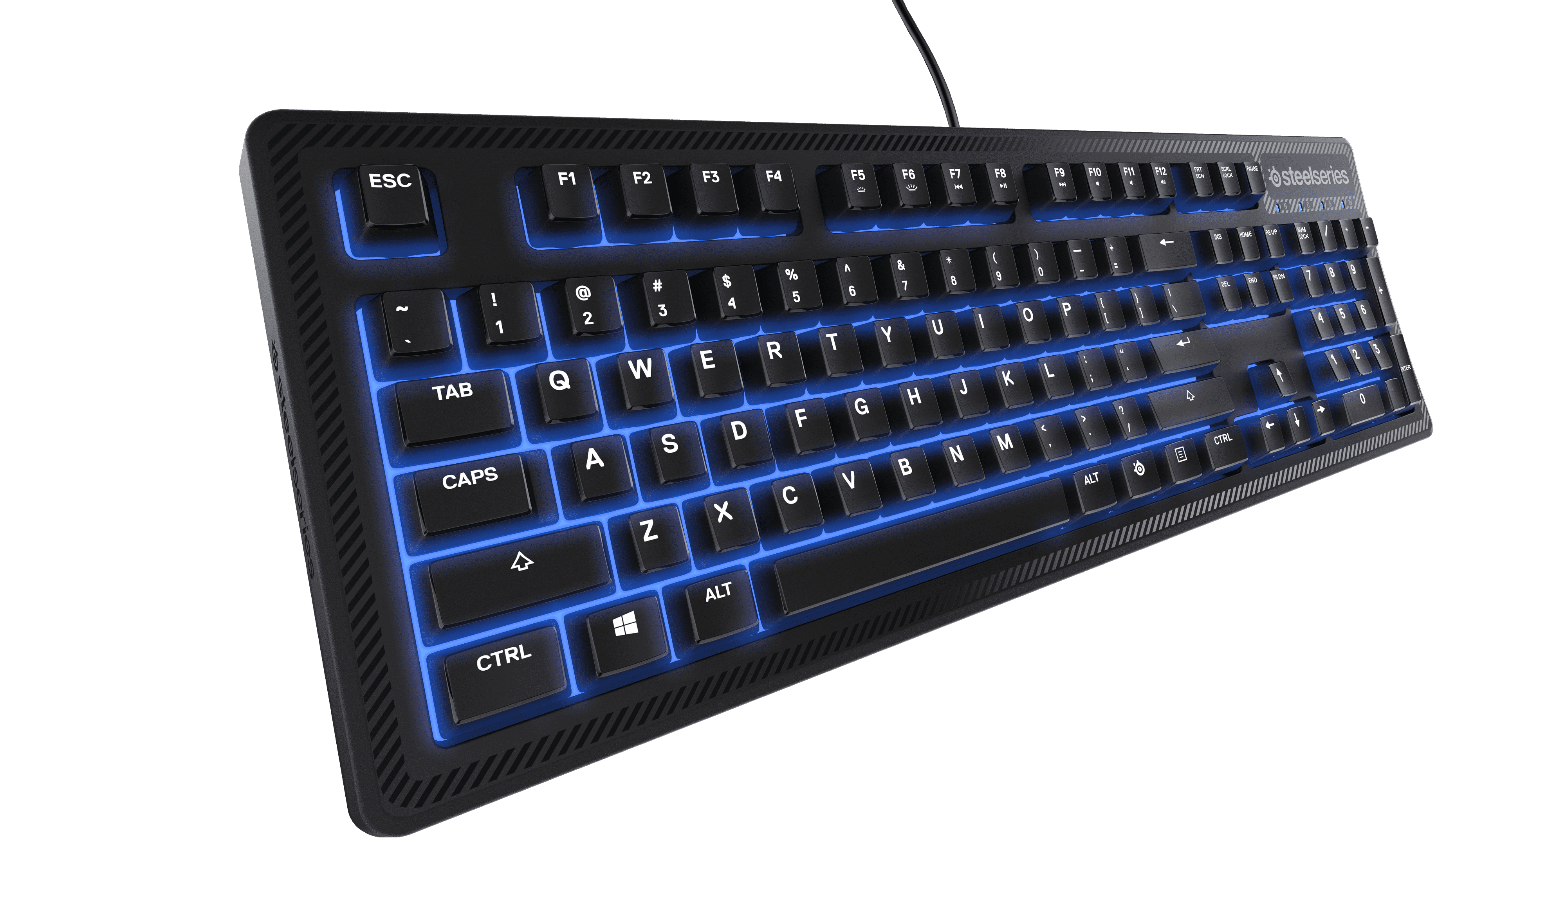
POLLING AND INTERRUPTS
The CPU also has to notice when peripheral devices need attention
Polling means the CPU asks each device, over and over, if it has any updates
Simple to code, and predictable in timing
It wastes CPU cycles asking a device that likely hasn’t changed
Anything yet?
Anything yet?
Anything yet?

Slide 21

POLLING AND INTERRUPTS
An interrupt is a signal from the device saying it needs the CPU now
The CPU stops, saves its place, and runs an interrupt service routine
Then it restores its place and carries on where it left off
No cycles wasted while the device is idle
Your keyboard has worked this way the whole lesson

Slide 22
POLLING AND INTERRUPTS
You have to judge which suits a given situation
Events that happen infrequently?
Events that happen constantly?
Limited battery power devices?
Devices that update in fixed intervals?
Factor | Favours polling | Favours interrupts
Event frequency | Constant events | Rare events
CPU overhead | Predictable cost | No idle cost
Power source | Mains | Battery
Latency control | Tight and known | Varies with load

Slide 23

POLLING AND INTERRUPTS
Keyboards, mice and networking chips (internet) use interrupts
A real-time controller reading a sensor 10,000 times a second may poll
An interrupt can also be a security concern if a device can be impersonated
→ Notes Q7 (a)-(c) [4 marks]

Slide 24

MULTITASKING AND DEADLOCK [HL]
Multitasking is the OS keeping many processes alive at once
  It has to share the CPU, memory, files and devices between them
Resource contention is two processes wanting the same thing at once
  The OS decides who waits, and the waiting has to end eventually

Slide 25
MULTITASKING AND DEADLOCK [HL]
Have you ever tried to upload a file that you have open in Word to ManageBac?
  Does it let you upload it?
    Why or why not?

Slide 26
MULTITASKING AND DEADLOCK [HL]
This is resource contention PREVENTION
  The OS makes sure that you aren’t uploading a file you’re currently working on because that could cause the data to conflict and corrupt your file or crash the program(s)

Slide 27
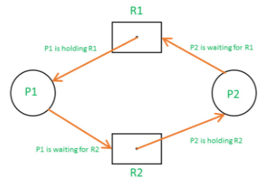
MULTITASKING AND DEADLOCK [HL]
Deadlock is a scenario when processes are waiting on something from each other, and neither can proceed
Process P1 holds the printer and wants the scanner, process P2 holds the scanner and wants the printer
Neither will release what it has, so both wait forever
Deadlock prevention is commonplace in programs nowadays, and processes will give up their resources after a certain amount of time to try again
→ Notes Q8 (a)-(c) [3 marks]

Slide 28
LAB
→ Notes Q9, Q10 and Q11 [8 marks]
Q9 Explain why round robin gives a better response time than FCFS [3]
Q10 Evaluate polling rather than interrupts for a sensor read 10,000 times a second [3]
Q11 Describe what is meant by starvation in priority scheduling [2]

Slide 29

VOCABULARY TO REMEMBER
Process
Thread
Ready queue
Burst time
Waiting time
Response time
First-come first-served
Round robin
Time quantum
Context switch
Priority scheduling
Starvation
Multilevel queue
Polling
Interrupt
Deadlock

